Slide 1


21 DAYS OF
MACHINE LEARNING
19/21
---Code Warriors---

Slide 2

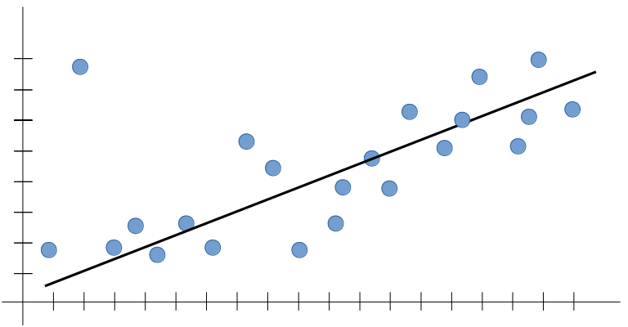
What is a Good Model
A model that generalizes well is a model that is neither underfit nor overfit.
---Code Warriors---

Slide 3
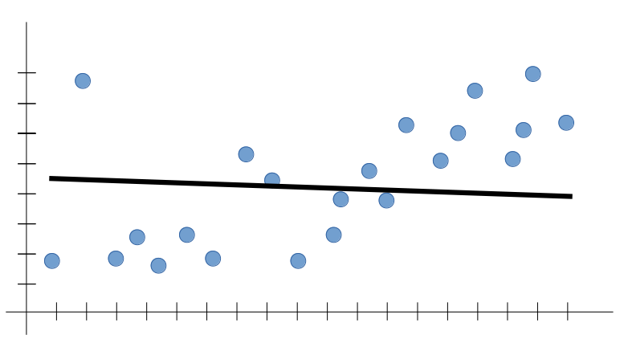
What is Underfitting
A statistical model or a machine learning algorithm is said to have underfitting when it cannot capture the underlying trend of the data.
---Code Warriors---

Slide 4
Techniques to reduce underfitting
Increase model complexity
Increase number of features, performing feature engineering
Remove noise from the data.
---Code Warriors---

Slide 5
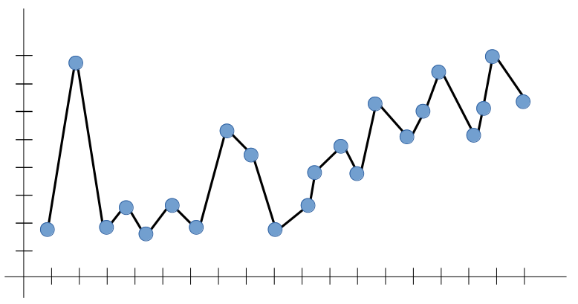
What is Overfitting
A statistical model is said to be overfitted, when we train it with a lot of data. When a model gets trained with so much of data, it starts learning from the noise and inaccurate data entries in our data set.
---Code Warriors---

Slide 6
Techniques to reduce overfitting
Increase training data.
Reduce model complexity.
Ridge Regularization and Lasso Regularization.
---Code Warriors---

